Slide 1


Welcome to Your Online Bus Ticket Booking System
Welcome to our cutting-edge online bus ticket booking system! We are committed to revolutionizing the way you travel by offering a seamless, user-friendly platform for booking your next bus journey. Our system is designed to provide a convenient and efficient way to secure your bus tickets, no matter where you're headed. With our comprehensive features, you can easily explore bus schedules, compare prices, choose your preferred seats, and make secure payments, all from the comfort of your own home or device.
A.SARVANI KANYAKA-192211795
Y.SAIKIRAN – 192211713
A.SUJITHA REDDY-192211824

Slide 2

Key Features of the Website
1
Seamless User Interface
Our user-friendly interface is intuitive and straightforward, making it easy for anyone to navigate and find the information they need. The clean layout and simple design ensure a smooth and enjoyable booking experience.
2
Comprehensive Bus Network
We offer a vast network of bus routes, connecting you to destinations across the country. Whether you're traveling for business or pleasure, our extensive network ensures you'll find the perfect route for your journey.
3
Real-time Updates
Stay informed with our real-time bus schedule updates, ensuring you have access to the most current information on bus arrivals, departures, and any potential delays.
4
Secure Payment Gateway
We prioritize your security by using a secure payment gateway, ensuring your personal and financial information is protected throughout the booking process. Choose from various payment methods, including credit cards, debit cards, and online payment platforms.

Slide 3

User Registration and Authentication
1
Create an Account
Get started by creating a free account using your email address and choosing a secure password. This allows you to save your preferences, manage your bookings, and access your travel history.
2
Verification
We send a confirmation email to your registered address, requiring you to verify your email to activate your account and ensure its security.
3
Login and Access
Once verified, you can log into your account using your registered email and password. You'll have access to your personal dashboard, where you can view and manage your bookings, update your profile information, and access other features.

Slide 4
Bus Schedule and Route Information
Departure and Arrival Points
Date and Time Selection
Bus Type and Amenities
Choose your preferred travel date and time using our user-friendly calendar interface. We provide flexible options to suit your schedule.
Filter your search results by bus type, such as standard buses, deluxe buses, or sleeper buses, and choose the amenities that are important to you, such as air conditioning, Wi-Fi, or comfortable seating. Our system allows you to select the bus that best meets your needs and preferences.
Easily select your desired departure and arrival points using our intuitive search bar. Enter the cities or specific locations you're traveling from and to.

Slide 5
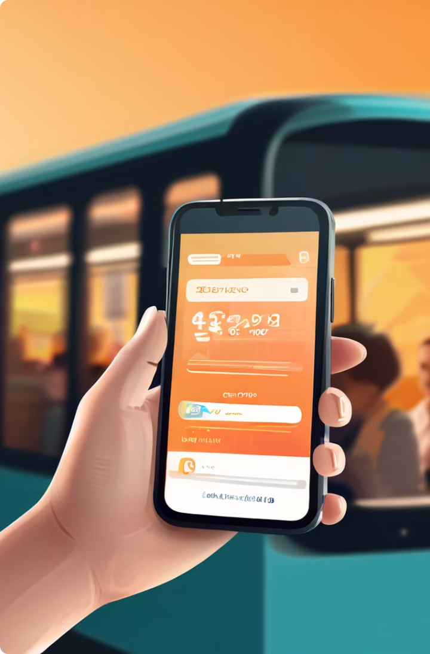




Ticket Booking and Payment Process
Select Your Ticket
Browse through available bus schedules, compare prices, and select the ticket that best suits your travel requirements. You can view details about the bus, amenities, and seating arrangement.
Enter Passenger Details
Provide the necessary passenger information, including name, age, contact details, and any special requirements. You can also select the number of tickets needed.
Choose Your Payment Method
Select your preferred payment method from our secure and reliable payment gateway. Choose from credit cards, debit cards, online wallets, or other available options.
Confirm and Complete Booking
Review your booking details, including passenger information, bus details, and payment summary. Once confirmed, complete your booking and receive your ticket confirmation via email.

Slide 6
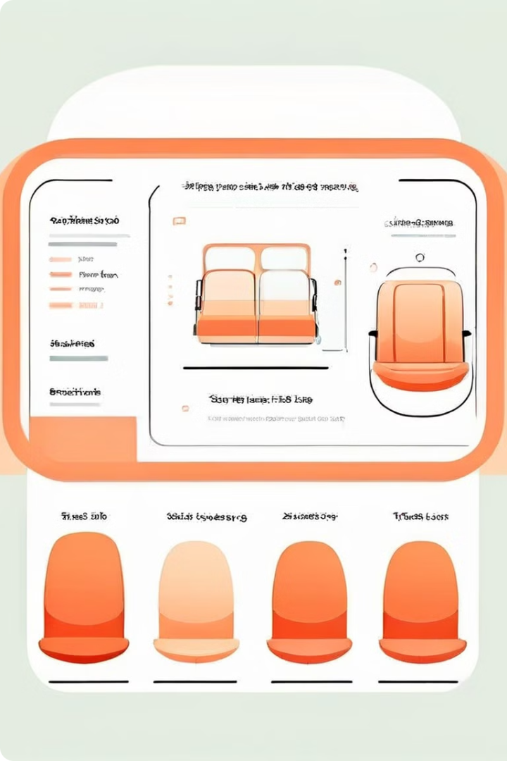
Seat Selection and Reservation
Type
Description
Standard
Comfortable standard seats with ample legroom.
Deluxe
Wider and more spacious seats with added legroom and recline options.
Sleeper
Fully reclining seats that convert into beds for overnight journeys.

Slide 7





Customer Support and Feedback
Live Chat Support
Connect with our friendly customer support team in real-time through our live chat feature for instant assistance with your bookings, questions, or any concerns you may have.
Phone Support
Reach out to our dedicated customer support team via phone for personalized assistance and to resolve any issues you might encounter.
Email Support
Send us an email with your inquiries or feedback, and our customer support team will respond promptly and provide the necessary assistance.
Feedback Form
Share your valuable feedback and suggestions through our online feedback form. Your input is important to us as we strive to continuously improve our services and meet your needs.

Slide 8
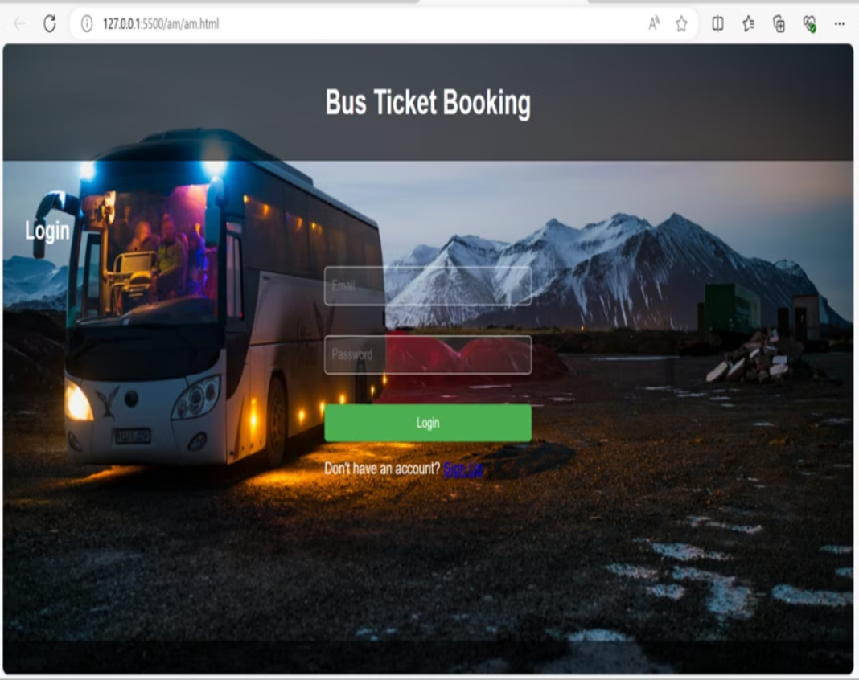
output:

Slide 9

Conclusion and Call-to-Action
Our online bus ticket booking system is designed to simplify your travel experience, offering a convenient, efficient, and secure platform to book your next bus journey. We are committed to providing a smooth and enjoyable experience, ensuring you can easily explore schedules, compare prices, select your preferred seats, and make secure payments. Start your next adventure with our online bus booking system. Book your tickets today and enjoy a hassle-free travel experience!

Slide 10


